Slide 1

School of Electronics Engineering
NCSET Conference Presentation

Slide 2
IOT SENSOR DATA VALIDATION AND FAULT DATA ACCOMMODATION USING SARIMA
MELVIN P. BABY 19MES1019
Guide : Prof. ABRAHAM SUDHARSON PONRAJ

Slide 3
CONTENTS
OBJECTIVE
MOTIVATION
BLOCK DIAGRAM OF MACHINE LEARNING
COMPONENTS REQUIRED
BLOCK DIAGRAM OF INTERFACING
ARIMA MODEL
RESULTS
CONCLUSION
FUTURE WORK
REFFERENCES

Slide 4
OBJECTIVE
Detection of sensor failure using forecasting techniques and accommodation of faulty data using machine learning

Slide 5
MOTIVATION
Our intention is to provide error free data.
The sensing systems are prone to failure due to environmental conditions.
The data from these sensors would downgrade the performance of an entire monitoring system.
Therefore detecting early sensor failure will enhance monitoring capabilities for effective management.

Slide 6
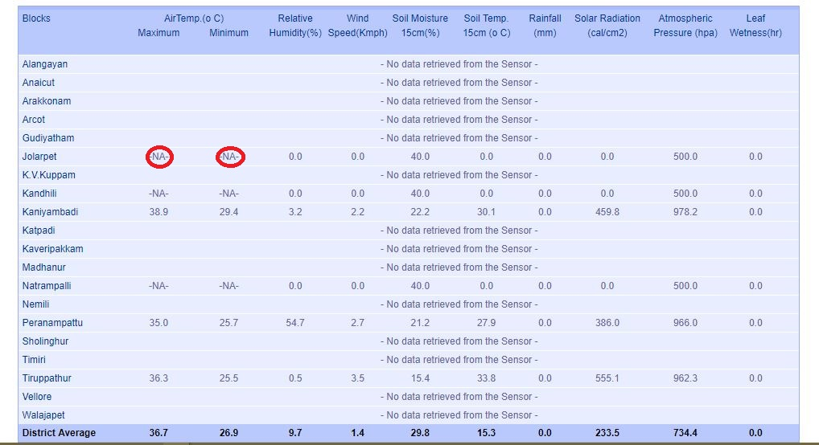
OBSERVATION
NA-NOT AVAILABLE

Slide 7
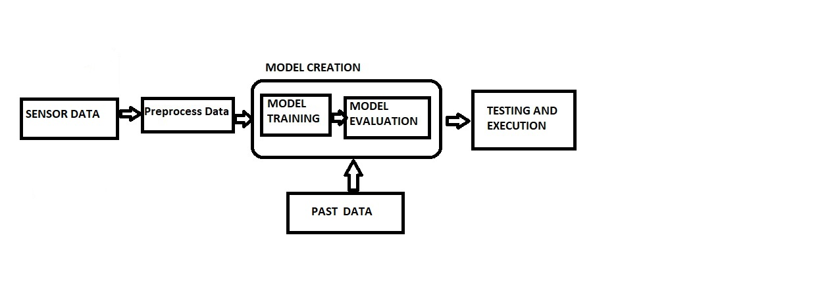
BLOCK DIAGRAM OF MACHINE LEARNING

Slide 8
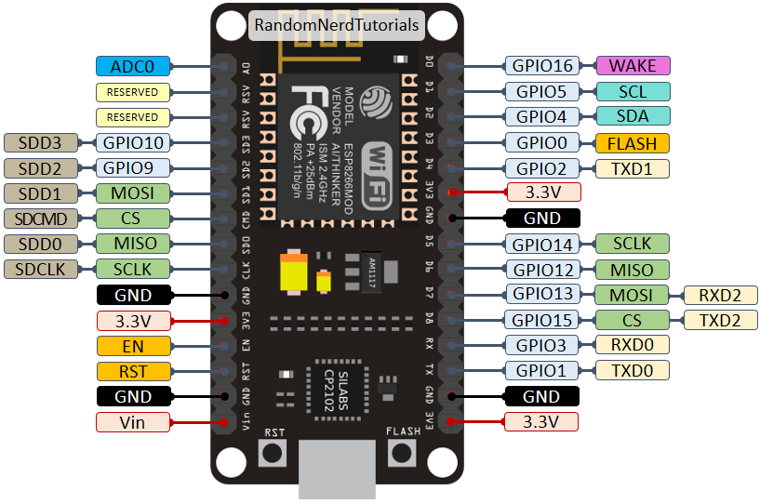
COMPONENTS REQUIRED
NODEMCU ESP8266(PIN DIAGRAM)

Slide 9
FEATURES
NodeMCU is a Firmware on ESP8266. Its basically an SoC
16 GPIO pins
80MHz, 128KB memory
5V USB supply
Operating range – 3.3v

Slide 10
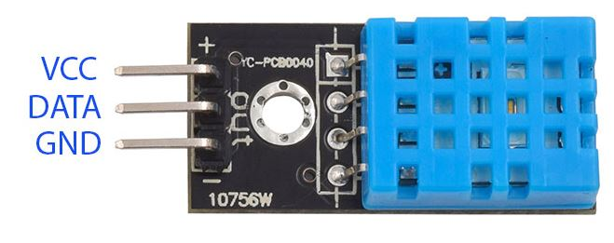
DHT11(TEMPERATURE AND HUMIDITY SENSOR)

Slide 11
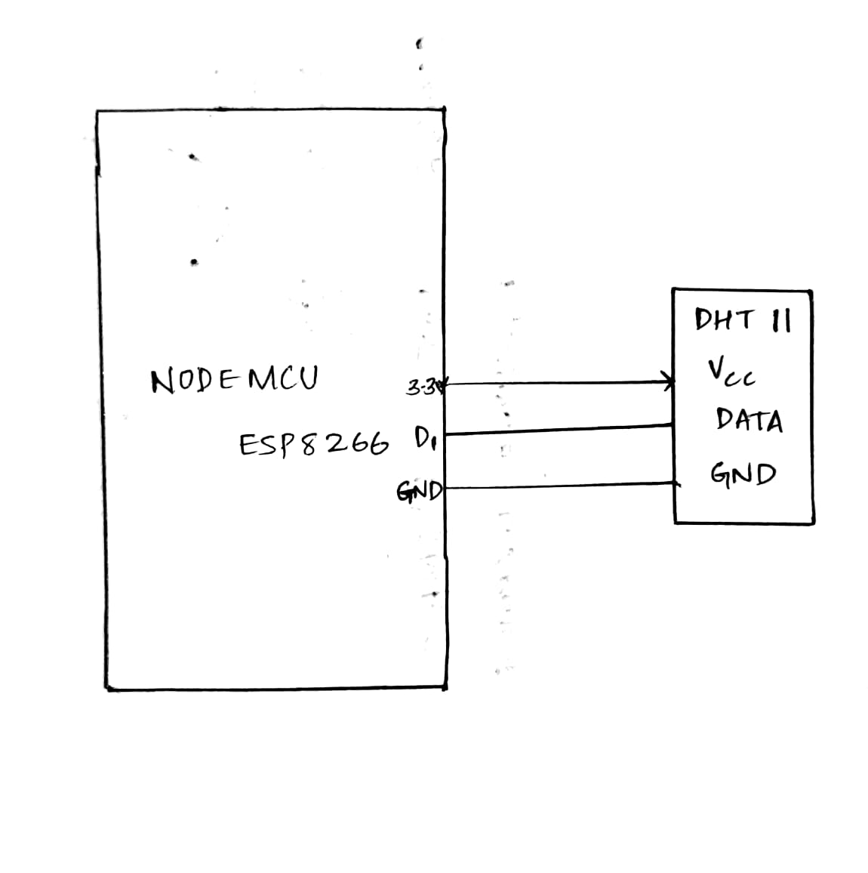
BLOCK DIAGRAM OF INTERFACING

Slide 12
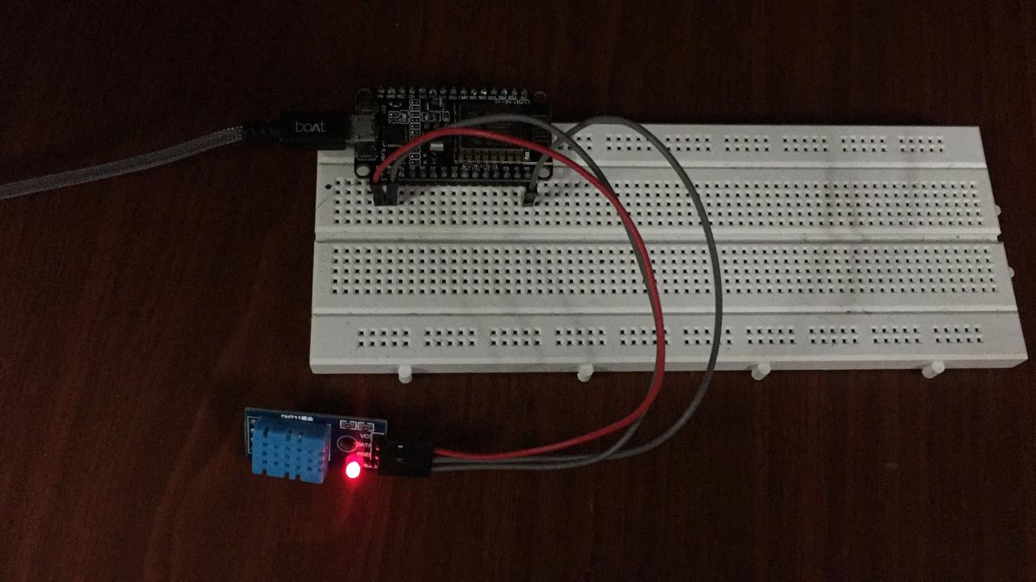
WORKING

Slide 13
SARIMA MODEL
It is a combination of two models, AR and MA models. ARIMA is a forecasting technique that projects the future values of a series. Its main application is in the area of short term forecasting requiring past dataset.

Slide 14
AR Model
An autoregressive (AR) model predicts future behavior based on past behavior. It’s used for forecasting when there is some correlation between values in a time series and the values that precede and succeed them. We only use past data to model the behavior, hence the name autoregressive
X(t) = A(1) * X(t-1) + E(t)
where X(t) = time series under investigation
A(1) = the autoregressive parameter of order 1
X(t-1) = the time series lagged 1 period
E(t) = the error term of the model

Slide 15
X(t) = A(1) * X(t-1) + A(2) * X(t-2) + E(t)
This indicates that the current value of the series is a combination of the two immediately preceding values, X(t-1) and X(t-2), plus some random error E(t). Our model is now an autoregressive model of order 2.

Slide 16
MA Model
Moving average parameters relate what happens in period t only to the random errors that occurred in past time periods, i.e. E(t-1), E(t-2), etc. rather than to X(t-1), X(t-2), X(t-3) as in the autoregressive approaches. A moving average model with one MA term may be
X(t) = B(1) * E(t-1) + E(t)
The term B(1) is called an MA of order 1. The above model simply says that any given value of X(t) is directly related only to the random error in the previous period, E(t-1), and to the current error term, E(t).

Slide 17
An ARIMA model is usually stated as ARIMA(p,d,q). This represents the order of the autoregressive components (p), the number of differencing operators (d), and the highest order of the moving average term. For example, ARIMA(2,1,1) means that you have a second order autoregressive model with a first order moving average component whose series has been differenced once to induce stationarity

Slide 18
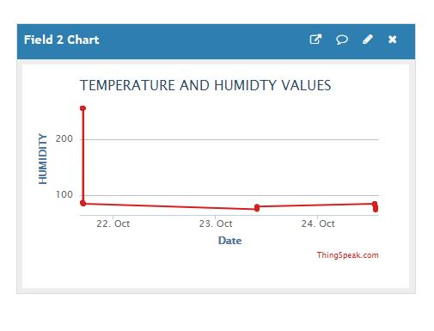
RESULTS
Fig 1: Sending the temp data to cloud

Slide 19
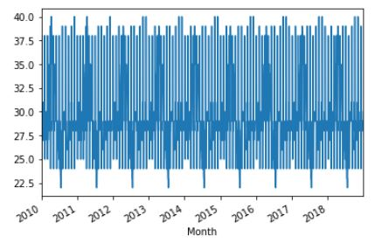
Fig2. Representation of past dataset of temperature (2010-2018)

Slide 20
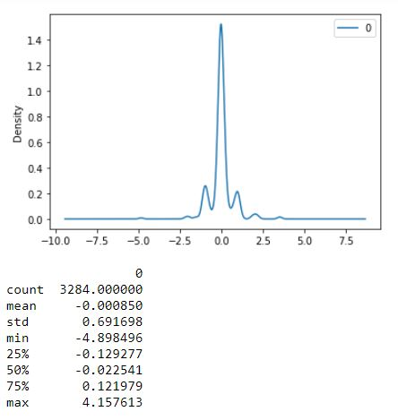
Fig3: Residual

Slide 21
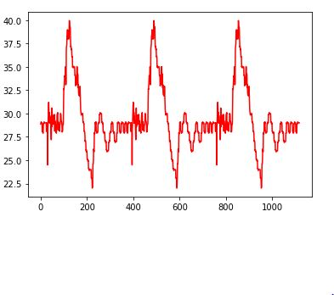
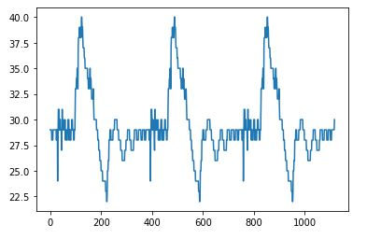
Fig 4: Predicted output
Fig 5: Expected output

Slide 22
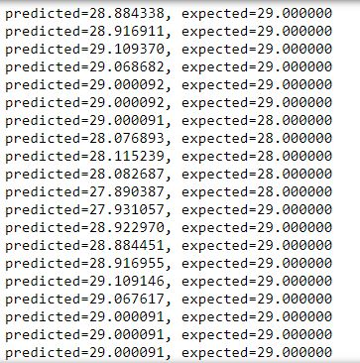
Fig 6 : Predicted output and Expected output

Slide 23
CONCLUSION
The proposed method that is SFDFDA approach can be used with the aid of machine learning to predict the sensor parameters in addition to detecting sensor faults and irregularities for weather monitoring system.

Slide 24
FUTURE WORK
In future, the fault accommodation that is detecting the sensor fault data and accommodating the accurate data will be completed with the help of machine learning which would complete our objective.

Slide 25
REFERENCES
[1] T. Chakraborty et al., “Fall-curve: A novel primitive for IoT Fault detection and isolation,” SenSys 2018 - Proc. 16th Conf. Embed. Networked Sens. Syst., pp. 95–107, 2018.
[2] K. Thiyagarajan, S. Kodagoda, L. Van Nguyen, and R. Ranasinghe, “Sensor failure detection and faulty data accommodation approach for instrumented wastewater infrastructures,” IEEE Access, vol. 6, no. October, pp. 56562–56574, 2018.
[3] P. Y. Chen, S. Yang, and J. A. McCann, “Distributed real-time anomaly detection in networked industrial sensing systems,” IEEE Trans. Ind. Electron., vol. 62, no. 6, pp. 3832–3842, 2015.
[4] D. Nozaki, “Method for Network Weather Monitoring System,” pp. 1–6, 2017.
[5] A. Salehian, “ARIMA Time Series Modeling for Forecasting Thermal Rating of Transmission Lines,” Proc. IEEE Power Eng. Soc. Transm. Distrib. Conf., vol. 3, pp. 875–879, 2003.
[6] V. Chatzigiannakis and S. Papavassiliou, “Diagnosing anomalies and identifying faulty nodes in sensor networks,” IEEE Sens. J., vol. 7, no. 5, pp. 637–645, 2007.
[7] N. S. Nalawade and M. M. Pawar, “Forecasting telecommunications data with Autoregressive Integrated Moving Average models,” 2015 2nd Int. Conf. Recent Adv. Eng. Comput. Sci. RAECS 2015, no. December, pp. 1–6, 2016.
[8] W. Yuan, L. Zhou, D. Guan, G. Han, and L. Shu, “Anomaly Detection for Civil Aviation Pilots Using Step-Sensors,” IEEE Access, vol. 5, no. X, pp. 11236–11243, 2017.
[9] J. Contreras, R. Espínola, F. J. Nogales, and A. J. Conejo, “ARIMA models to predict next-day electricity prices,” IEEE Trans. Power Syst., vol. 18, no. 3, pp. 1014–1020, 2003.

